Slide 1

Cloud computing - AWS
Sutex Bank College of Computer Applications & Science, Amroli
When it’s smarter to rent
Than to buy …
Prepared By :
Jagani Mukund N.
seat No.: 4663
TYBCA Div. – 6
Guided By :
Asst. Prof. Nensi h. modi

Slide 2
Index
Introduction
Architecture of cloud computing
Characteristic Of Cloud Computing
Cloud service model
Is Cloud Computing reduces e-waste
Advantages
Disadvantages
Amazon Web services
Competitors of AWS
Customer of AWS
Conclusion

Slide 3
Definition of cloud computing
Computing and Software resources that are delivered on demand , as services
(2013,January) A Walk in the clouds. Cloud Computing ,CDW-G Reference Guide.,3-5.
The Cloud is actually a bunch of computer server that store and transmit data . These servers are very large and can hold massive amount of data . The servers can be housed any where in the world . The user accesses the data by log-in form any where

Slide 4
Meaning of cloud computing
Common implies multi-tenancy, not single or isolated tenancy
Location-independent
Online
Utility implies pay-for-use pricing
Demand implies infinite, immediate, invisible scalability

Slide 5
Types of cloud services
Email
Storage, backup, and data retrieval
Creating and testing apps
Analyzing data
Audio and video streaming
Delivering software on demand
Cloud computing is still a fairly new service but is being used by a number of different organizations from big corporations to small businesses, nonprofits to government agencies, and even individual consumers.

Slide 6
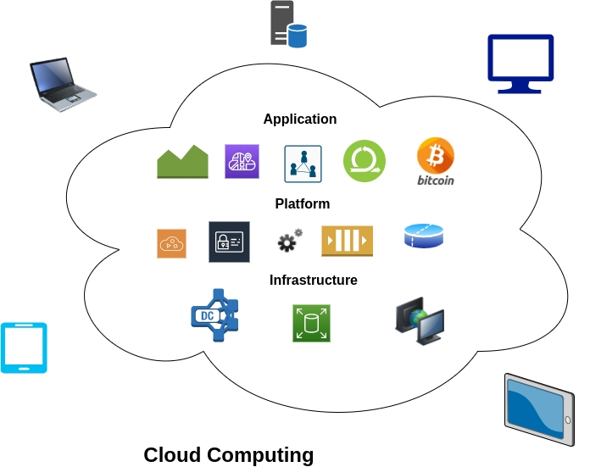
Architecture of cloud computing

Slide 7
Characteristic of cloud computing
Rapid Elasticity
On-Demand Self-Service
Cloud Computing
Resource Pooling
Flexible Pricing – Pay Per Use
Ubiquitous
Network
Access

Slide 8
Cloud service model
Software as a Service (SaaS)
Platform as a Service (PaaS)
Infrastructure as a Service (IaaS)
PaaS
IaaS
SaaS
End Users
Value visibility to End User
Application Developer
Networks Architects

Slide 9
infrastructure as a Service (IaaS)
IaaS is the delivery of technology infrastructure on demand scalable service.
Network Architects
IT administrators
Vmware , AWS(Amazon Web Services) , rackspace , Alibaba cloud

Slide 10
Platform as a Service (PaaS)
PaaS provides all of the facilities required to support the complete life cycle of building and delivering web application and services entirely from the Internet.
Application Developers
Rollbase , Microsoft Azure , OpenShift , Github

Slide 11
Software as a Service (SaaS)
SaaS is Software delivery methodology
That provide licensed multi-tenant access to software and its function remotely as a web-based services.
End Users
Google , salesforce , IBM , Netflix , HubSpot , Office 365

Slide 12
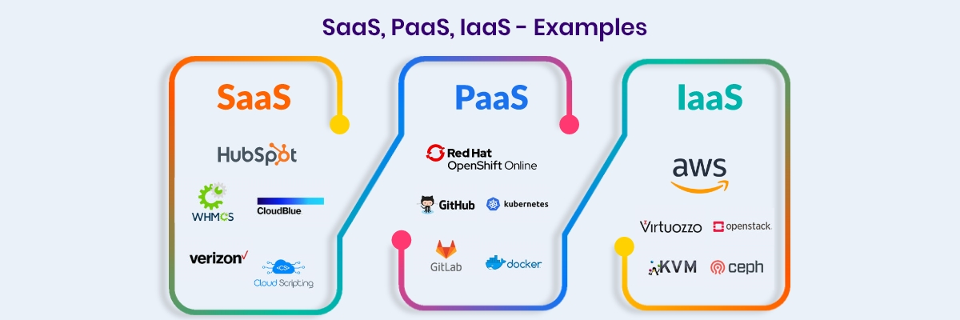
Service Delivery model example

Slide 13
Cloud deployment model
Private Cloud
Public Cloud
Hybrid Cloud

Slide 14
Private cloud
Private cloud is cloud infrastructure operated solely for a single organization, whether managed internally or externally.
These services use storage capacity and processor power that is not owned by the organization or business.
Less cost-efficient
IBM , SUN , Oracle

Slide 15
public cloud
Public cloud is a style of computing where scalable and elastic IT-enabled capabilities are provided as a service to external customer using Internet technologies.
i.e., Public cloud computing uses cloud computing technologies to support customer that are external to the provider’s organization.
Amazon, Google , Microsoft

Slide 16
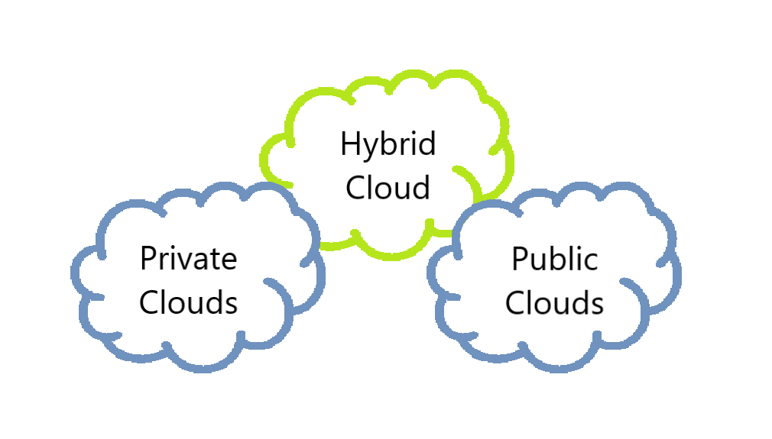
hybrid cloud
Private cloud + Public cloud = Hybrid cloud

Slide 17
hybrid cloud
Hybrid cloud is a composition of two or more clouds (private, community or public) that remain distinct entities but are bound together, offering the benefits of multiple deployment models.
Hybrid cloud can also mean the ability to connect collection, managed and dedication services with cloud resources.
AWS Outposts, Azure stack, Google Anthos, Vmware Cloud

Slide 18
Cloud deployment model
Private Cloud
Public Cloud
Co-brand vCloud Services
Cloud Consumption vCloud
Operations and Management
vCenter
Security and Compliance
vShield
Virtualization
vSphere
vCloud Datacenter
Security & Performance for enterprises
Hybrid Cloud
Portability
vCloud Express
Rapid Credit-card payment developers
Cross-Cloud Standards
vCloud API
Open virtualization Format
Cross-Cloud Standards
vCloud Connector
vCloud Powered
Broad array of Vmware-compatible clouds for any business need

Slide 19
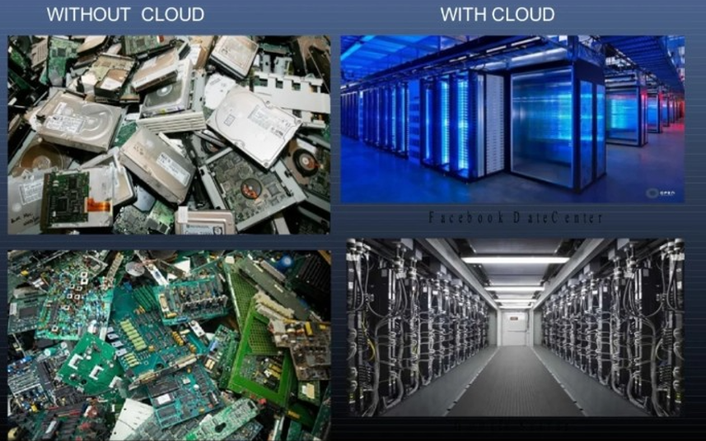
Is cloud computing reduces e-waste ?
Green IT Cloud Computing
Cloud Computing is Eco-Friendly
We can reduce E-waste by using Cloud Computing i.e. By Infrastructure as a Service(IaaS)
Cloud Computing Helps to Accelerate Green IT
Can Reduce Global Warming too…..

Slide 20
Advantages
Location
Infinite Storage
Environment Friendly
Cost Proficient
More Secure
More Flexible
Software Integration
Backup& Recovery
Document Control
Rapid Development
Streamline
Workflow
Independent

Slide 21
Disadvantages
Requires a constant internet connection
Limited Features
May be slow
Doesn’t work well in low speed connection

Slide 22
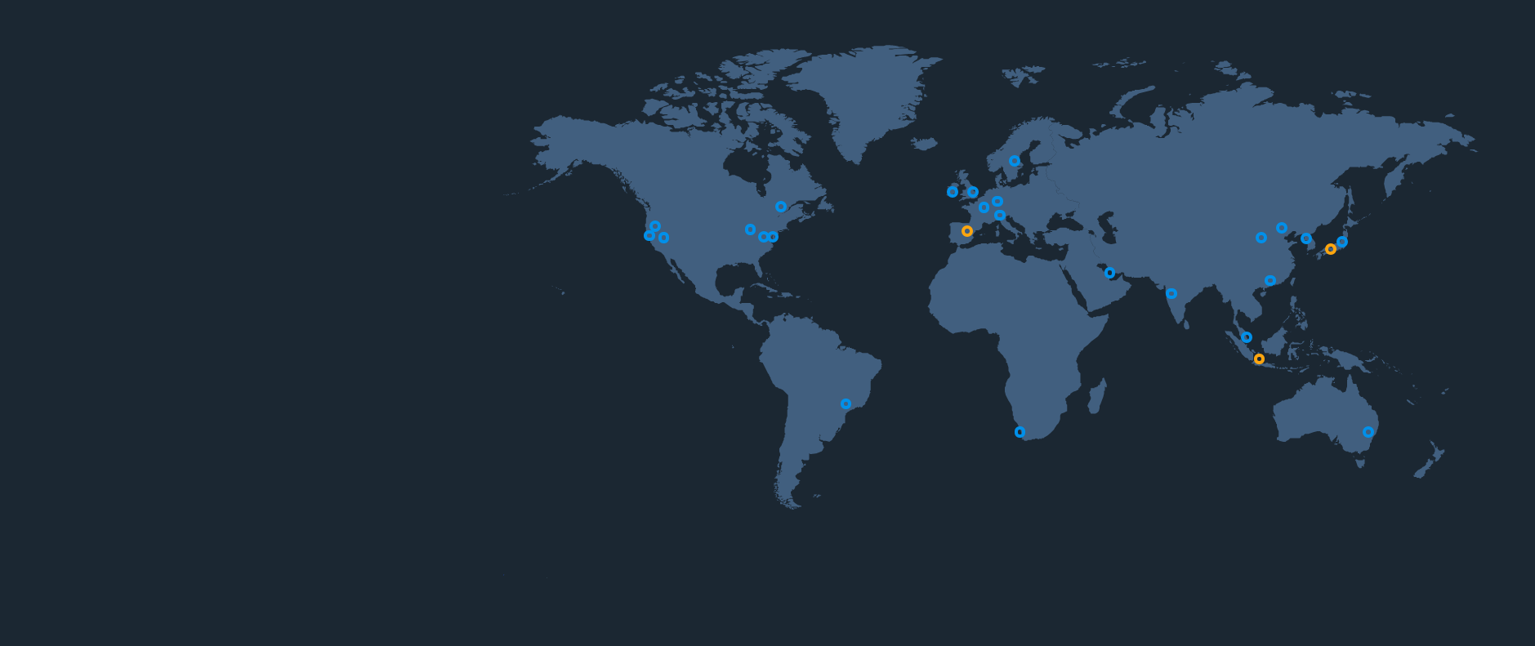

Amazon Web services
26 Regions
84 Availability Zones
52 Edge Locations
YOU CHOOSE WHERE YOUR APPS AND DATA GO!

Slide 23
AWS (Amazon Web Services) is a subsidiary of Amazon.com
It provide on-demand cloud computing platforms.
The AWS technology is implemented at server farms throughout the world, and maintained by the Amazon subsidiary.
A data center is also called server farm.
It is a facility used to house computer systems and associated components , such as telecommunication and storage systems.
AWS are operated from 16 geographical regions across the world and operated using zone and edge location.
AWS is the world’s most comprehensive and broadly adopted cloud platform , offering 200 fully featured services from data center globally

Slide 24
NASA JPL uses AWS for Image Processing and streaming of the Mars Landing
Obama for the America used AWS to run Mission Critical Applications
Apple spends more than $30 million on Amazon’s AWS every month(Biggest AWS Customer)
AWS serves over a million active customer in more than 240 countries and territories

Slide 25
Competitors
Google Cloud Platform
Microsoft Azure
IBM Cloud
Oracle Cloud
Vmware Cloud
Dell Technologies Cloud
Alibaba Cloud

Slide 26
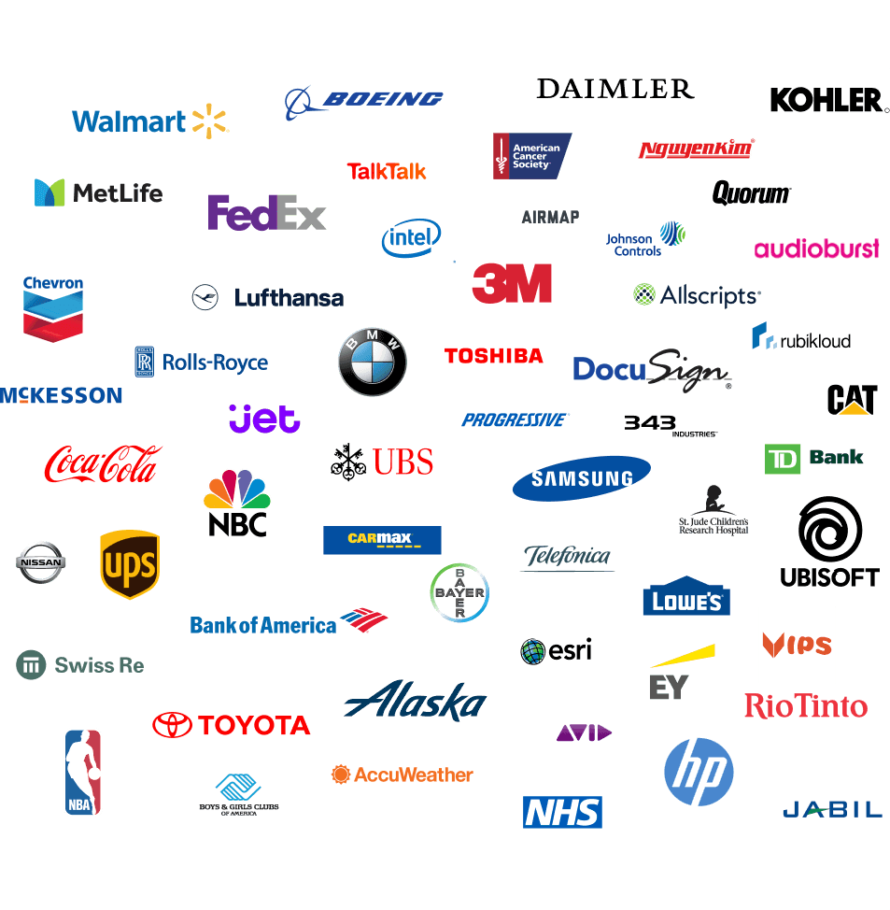
Customers

Slide 27
Conclusion
Cloud Computing holds some strong promises
Highly Available
Pay only for resources that you use
Cloud Computing is not yet well understood
Cloud Computing is new technological development that has the potential to have a great impact on the world
Reduce operating cost by spending on maintenance and software upgrades and focus more on the businesses

Slide 28
references
https://www.geeksforgeeks.org
https://en.wikipedia.org/wiki
https://www.javatpoint.com

Slide 29
THANK
YOU

